Slide 1


Problem Decomposition
1

Slide 2
Computational Thinking in Practice
Before computers can solve a problem, the problem and the ways in which it can be resolved must be understood.
2

Slide 3
Computational Thinking in Practice
A complex problem is one that, at first glance, we don't know how to solve easily.
Computational thinking involves taking that complex problem and breaking it down into a series of small, more manageable problems (decomposition).
Each of these smaller problems can then be looked at individually, considering how similar problems have been solved previously (pattern recognition) and focusing only on the important details, while ignoring irrelevant information (abstraction).
Next, simple steps or rules to solve each of the smaller problems can be designed (algorithms).
Finally, these simple steps or rules are used to program a computer to help solve the complex problem in the best way.
3

Slide 4







Decomposition
Decomposition helps by breaking down complex problems into more manageable parts.
Decomposition is one of the four cornerstones of Computer Science.
It involves breaking down a complex problem or system into smaller parts that are more manageable and easier to understand.
The smaller parts can then be examined and solved, or designed individually, as they are simpler to work with.
Problem
Sub Problem 1
Sub Problem 2
Sub Problem N
4

Slide 5
Why is Decomposition important?
If a problem is not decomposed, it is much harder to solve.
Dealing with many different stages all at once is much more difficult than breaking a problem down into a number of smaller problems and solving each one, one at a time.
Breaking the problem down into smaller parts means that each smaller problem can be examined in more detail.
Similarly, trying to understand how a complex system works is easier using decomposition.
For example:
understanding how a bicycle works is more straightforward if the whole bike is separated into smaller parts and each part is examined to see how it works in more detail.
5

Slide 6
Example # 1
We do many tasks on a daily basis without even thinking about – or decomposing – them, such as brushing our teeth.
To decompose the problem of how to brush our teeth, we would need to consider:
  which toothbrush to use
  how long to brush for
  how hard to press on our teeth
  what toothpaste to use
6

Slide 7













Example # 2
The process of making pizza can be split into six sub-problems :
Make Pizza
Make Crust
Make and Spread Sauce
Spread
Cheese
Spread
Toppings
Bake
Slice
Each sub problem is at (roughly) the same level of detail.
Each sub problem can be solved independently.
The solutions to the sub problems can be combined to solve the original problem.
  Do you see decomposition in your life? ?
If yes, what are they??

Slide 8
Decomposition in real life
General problem ---- sub-problems
Human body ---------- parts and its role
Family ------- individual responsibilities
Organization -------departments
Chemicals compounds ----- product molecules/elements/simple compounds
Numbers --- digits and its position
Velocity --- directions
Daily dish ------- ingredients
So on…

Slide 9
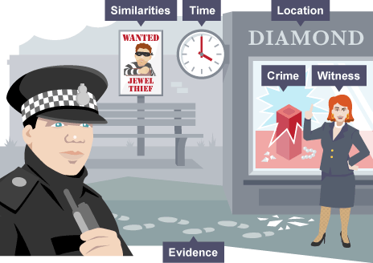
It is only normally when we are asked to do a new or more complex task that we start to think about it in detail – to decompose the task.
Imagine that a crime has been committed.
Solving a crime can be a very complex problem as there are many things to consider.

Slide 10
Example #3
For example, a police officer would need to know the answer to a series of smaller problems:
  what crime was committed
  when the crime was committed
  where the crime was committed
  what evidence there is
  if there were any witnesses
  if there have recently been any similar crimes
The complex problem of the committed crime has now been broken down into simpler problems that can be examined individually, in detail.

Slide 11
Imagine that you want to create your first app. This is a complex problem - there are lots of things to consider.
How would you decompose the task of creating an app?
To decompose this task, you would need to know the answer to a series of smaller problems:
  what kind of app you want to create
  what your app will look like
  who the target audience for your app is
  what your graphics will look like
  what audio you will include
  what software you will use to build your app
  how the user will navigate your app
  how you will test your app
  where you will sell your app

Slide 12

Imagine you want to organize all your DVDs alphabetically and you have a lot of them! Where would you start?
You might decompose the task into the following steps:
Take all the DVDs off your shelf.
Sort the DVDs into piles based on the first letter of the title.
Start with the 'A' pile. Organize this group into alphabetical order by second and third letters.
Place them on the shelf.
Repeat for the rest of the alphabet.

Slide 13
Imagine you want to create a Computer
This is a complex problem - there are lots of things to consider.
You might decompose the task into the following steps:
Come up with the idea
Create graphics
Program each sprite one at a time
Test your game
Debug and make improvements

Slide 14
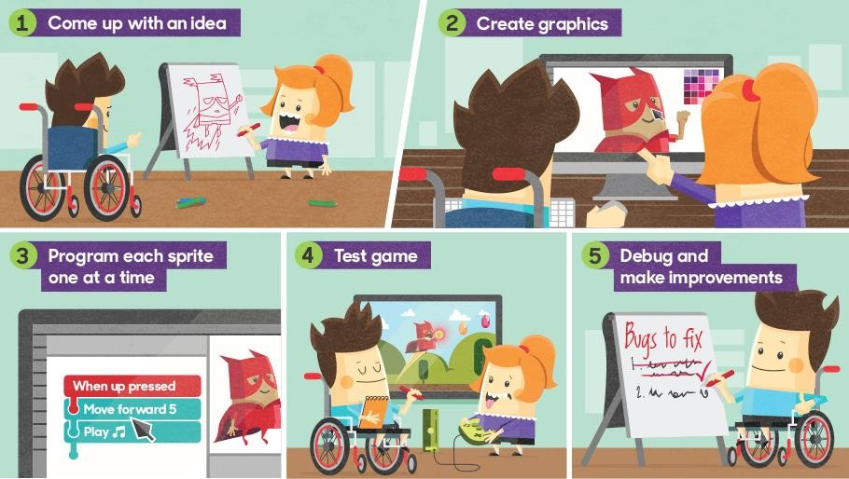
The game problem is decomposed into small task

Slide 15
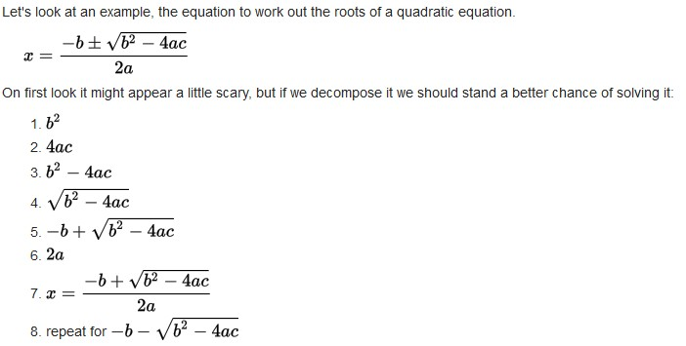
Steps in decomposing the equation of finding square roots of a quadratic equation

Slide 16
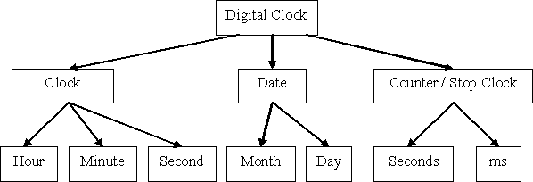
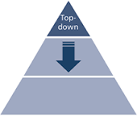
Decomposition – A Top Down approach

Slide 17

Creating an app
Imagine that you want to create your first app.
This is a complex problem - there are lots of things to consider.
Once we have decomposed a complex problem, it helps to examine the small problems for similarities or ‘patterns’.
These patterns can help us to solve complex problems more efficiently.

Slide 18
Solution:
To decompose this task, you would need to know the answer to a series of smaller problems:
  what kind of app you want to create
  what your app will look like
  who the target audience for your app is
  what your graphics will look like
  what audio you will include
  what software you will use to build your app
  how the user will navigate your app
  how you will test your app
  where you will sell your app
This list has broken down the complex problem of creating an app into much simpler problems that can now be worked out.
You may also be able to get other people to help you with different individual parts of the app.
For example, you may have a friend who can create the graphics, while another
will be your tester.

Slide 19
Pattern Recognition
Once we have decomposed a complex problem, it helps to examine the small problems for similarities or ‘patterns’.
These patterns can help us to solve complex problems more efficiently.
When we decompose a complex problem we often find patterns among the smaller problems we create.
The patterns are similarities or characteristics that some of the problems share.
Pattern recognition is one of the four cornerstones of Computer Science.
It involves finding the similarities or patterns among small, decomposed problems that can help us solve more complex problems more efficiently.

Slide 20
What are patterns?
Imagine that we want to draw a series of cats.
All cats share common characteristics.
Among other things they all have eyes, tails and fur.
They also like to eat fish and make meowing sounds.
Because we know that all cats have eyes, tails and fur, we can make a good attempt at drawing a cat, simply by including these common characteristics.
In computational thinking, these characteristics are known as patterns.

Slide 21
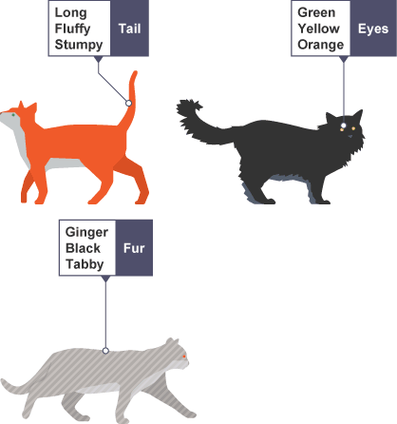
Once we know how to describe one cat we can describe others, simply by following this pattern.
The only things that are different are the specifics:
  one cat may have green eyes, a long tail and black fur
  another cat may have yellow eyes, a short tail and striped fur
Finding patterns is extremely important

Slide 22
Why are finding patterns important?
Patterns make our task simpler.
Problems are easier to solve when they share patterns, because we can use the same problem-solving solution wherever the pattern exists.
The more patterns we can find, the easier and quicker our overall task of problem solving will be.
If we want to draw a number of cats, finding a pattern to describe cats in general, eg they all have eyes, tails and fur, makes this task quicker and easier.
We know that all cats follow this pattern, so we don’t have to stop each time we start to draw a new cat to work this out.
From the patterns we know cats follow, we can quickly draw several cats.

Slide 23
What happens when we don’t look for patterns?
Suppose we hadn’t looked for patterns in cats,
Each time we wanted to draw a cat, we would have to stop and work out what a cat looked like.
This would slow us down.
We could still draw our cats - and they would look like cats - but each cat would take far longer to draw.
This would be very inefficient, and a poor way to go about solving the cat-drawing task.
In addition, if we don’t look for patterns we might not realise that all cats have eyes, tails and fur.
When drawn, our cats might not even look like cats.
In this case, because we didn’t recognise the pattern, we would be solving the problem incorrectly.

Slide 24
Recognising Patterns
To find patterns in problems we look for things that are the same (or very similar) in each problem.
It may turn out that no common characteristics exist among problems, but we should still look.
Patterns exist among individual problems.
We need to look for both.
different problems and within

Slide 25
For example:
each cake will need a precise quantity of specific ingredients
ingredients will get added at a specific time
each cake will bake for a specific period of time
Once we have the patterns identified, we can work on common solutions between the problems.

Slide 26

Case study time …..
26

Slide 27


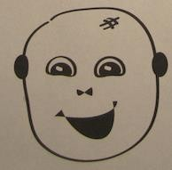
Draw a Monster
Given following monster head(first name) with features(last name). Can we write a set of instructions for a computer in order to draw a monster’s head with creating new monster catalogue?
Zombus Vegitas
Frankn Wackus
Happy Spritem

Slide 28
Decomposition:
  Break drawing process into smaller tasks.
  Create a list of things needed to be done.
  Use the list below to start. Can you think of other tasks to add to the list?
    Example List
      Create three different monsters.
      Sort monsters by face shape.
      Look for similarities in those monsters.
      Make a list of features to identify.
      Use identified features to create a new monster.
      Describe your new monster to your teammates in a step-by- step way and let them try to put it together.

Slide 29


Pattern Location:We can see that all monsters have a head, eyes, ears, nose and mouth.
Zombus
Frankn
Happy
Vegitas
Wackus
Spritem

Slide 30



Vegitas
Wackus
Spritem
Vegitas
Wackus
Spritem
Vegitas
Wackus
Spritem

